Slide 1


Slide 2





Background/Brief
Tu Me (Telefonica) PPC Test
Background
Tu Me – provider of a messaging/picture sharing app for smart phones.
iProspect approached for a 3 month PPC trial with the view of awarding iProspect the business if successful in the test.
Brief
Launch paid search activity across multiple markets – drive app downloads at a $6 CPA.
Successful completion of the test could lead to an extended Tu Me contract and other opportunities within the Telefonica brand.

Slide 3
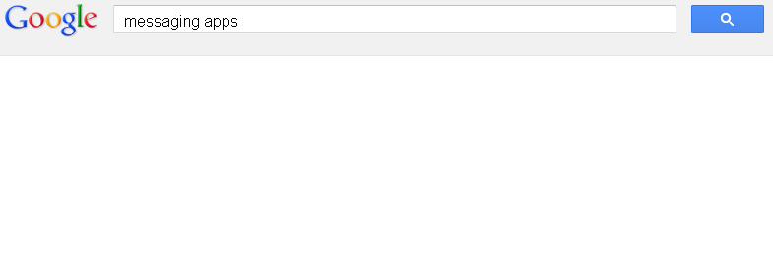





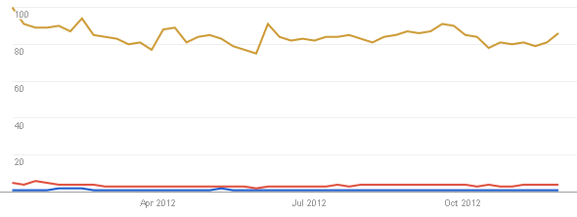



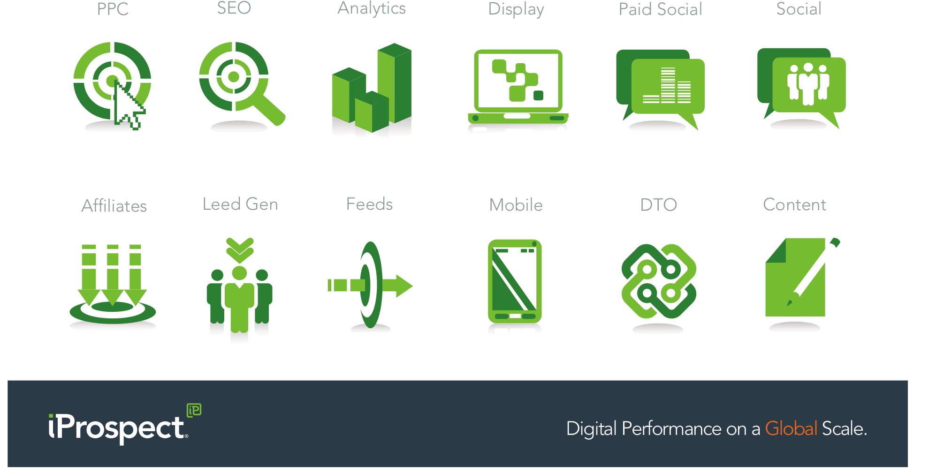
Challenge
Multiple Challenges
Challenges
No brand awareness – low traffic through brand terms.
High traffic volumes on generic terms but too expensive to deliver a $6 cost per download – highly saturated and competitive market.
Low brand traffic and expensive generic terms on mobile devices also .

Slide 4
Challenge
Multiple Challenges
Bhav to update – tried traditional paid search – no awareness on brand and generics too expensive.
Mobile, lower cpc but not strong conversion
GDN banner provided wide audience/reach and easy free download.

Slide 5




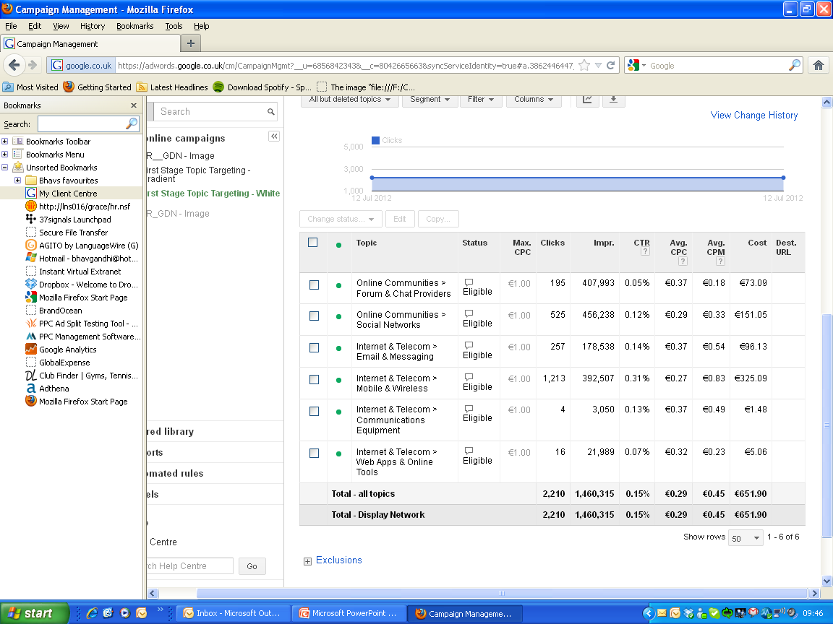



Strategy
Strategy
Push to Pull Marketing
With no brand awareness and high CPCs in traditional paid search, the strategy was changed from pull marketing to the push marketing of the GDN.

Slide 6
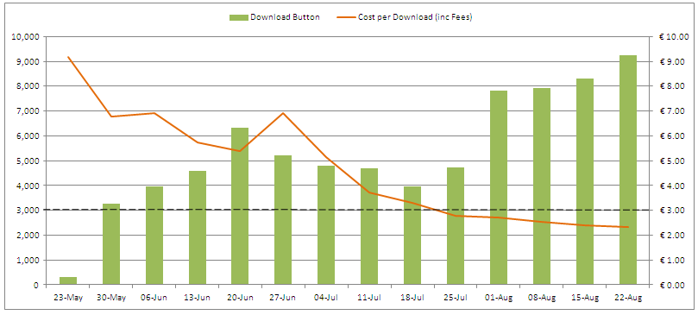




results
Completing the Digital Marketing Mix
Week on week reduction in CPA and increase in app downloads.
CPA well below the $6 KPI target.
€39k income in fee’s during test period.
Cross sold iProspect services.
Waiting for 2013 budgets.
Lead Gen
PPC
SEO
Paid Social

